Slide 1
Humor and Jokes
Bucă Mihnea-Vicențiu
Căpățînă Răzvan-Nicolae
Ciobanu Dragoș
Petre-Șoldan Adela

Slide 2
Introduction
Proposed Tasks:
Classify text as being humorous or non-humorous
Generate humorous texts/jokes starting from a given prompt

Slide 3
Dataset
5 datasets (4 for jokes, 1 for negative examples), pre-processed with columns: ID, Title, Category, Body, Rating
jokes range from short to long phrases and satirical setups
negative examples are obtained from news articles
for preprocessing we filter inappropriate content with regular expressions, clean our text, eliminate duplicates, split the jokes into setup and punchline
some datasets have a rating for each joke and we normalized them in range from 0 (non-joke, news) to 1

Slide 4
Humorous Text Classification Setup:
Transform the problem into a regression task:
assign a score between [0, 1] for each text
non-jokes receive a score of 0, while jokes have a score > 0
higher scores means more humorous samples
Train a regression model on these values and set a threshold above which samples will be considered jokes.

Slide 5
Classification Approaches:
Train model architecture from scratch (TF-IDF + Neural Network)
Fine-tune language model (BERT)

Slide 6
Model Architecture from Scratch
TF-IDF Vectorizer and Neural Network Method:
Obtain features generated by TF-IDF for each sample text
Train the Neural Network using these features
The model will output a single value between [0, 1], the predicted rating for each text
Used model architecture:
3 hidden fully-connected layers of size 512 neurons each
TF-IDF Vectorizer output is 4096 features
Trained the model on 10 epochs with constant learning rate of 0.001. Used Adam optimizer and MSE loss function.

Slide 7
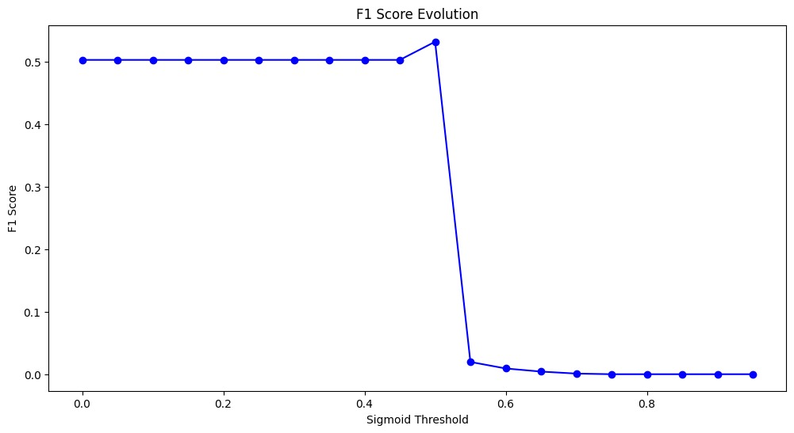
Iteratively went through all possible sigmoid threshold values from 0 to 1 with a step size of 0.05 to find the best F1 score for the Validation Set. Kept the best threshold found.

Slide 8
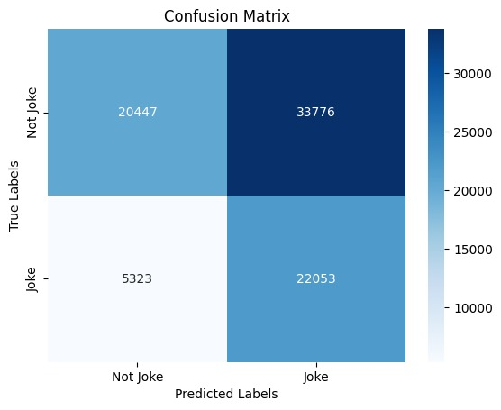
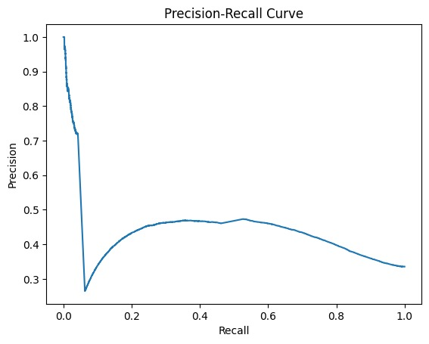
Results on Test Set:
Precision: 0.395
Recall: 0.805
F1 Score: 0.53

Slide 9
Transformer-Based Humor Regression with BERT
Fine-tune pre-trained bert-base-uncased model to predict continuous humor scores
After minimal cleaning, each joke is tokenized into 64 subword tokens
Replaced BERT’s classification head with a single linear output and train for 3–5 epochs using AdamW (lr=5e-5) to minimize MSE
Post-training, a sigmoid function is applied and an optimal threshold is selected on validation data to yield binary joke/non-joke predictions
This pipeline leverages contextual embeddings to capture semantic and pragmatic humor cues that sparse models cannot

Slide 10
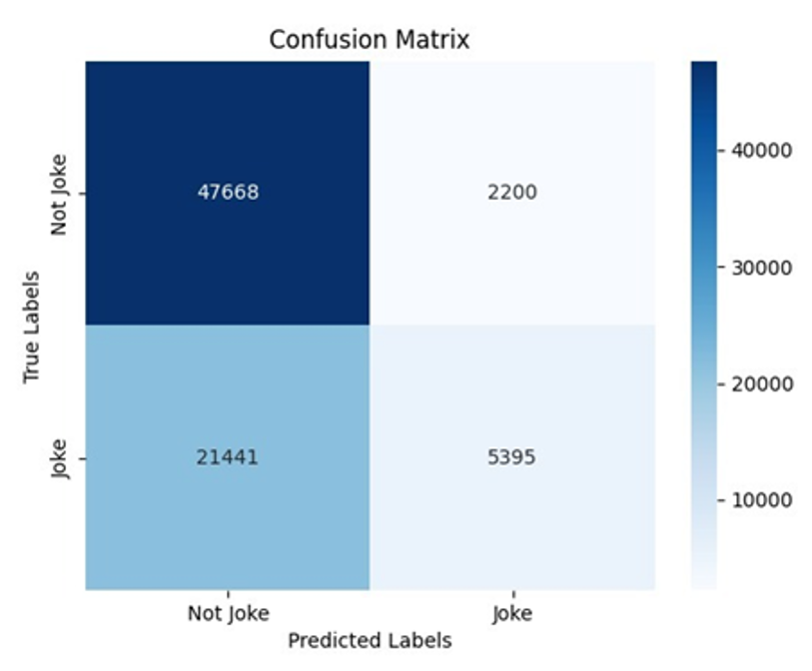
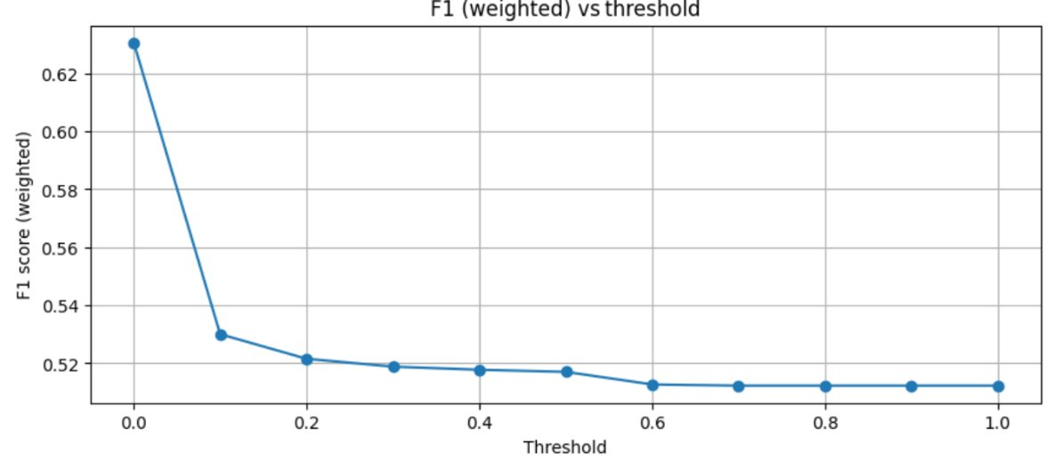
Results on Test Set:
Precision: 0.70
Recall: 0.58
F1 Score: 0.56

Slide 11
Humorous Text Generation
Generation Approaches:
Custom transformer from scratch
Fine-tune language models (GPT-2, BART

Slide 12
Custom Transformer for Next-Token from scratch
tensors dimensions = (sequences, token_ids, embedding).
layers: embedding, positional encoding, followed by 2-4 encoders, then an average pooling layer to get tensor(sequences, embedding) and a final dense layer with softmax activation to return probabilities for each token
encoder has self-attention, normalizations, feed forward layer with relu activation
sparse categorical cross-entropy
joke start and punchline separated by "<sep>" character, then word-level tokenized, transformed into multiple sequences
autoregressive generation: next token chosen based on all previous words
temperature prediction

Slide 13
BART Denoising autoencoder
BART fine-tune jokes generation method:
Input prompts and corresponding punchlines are tokenized using a BART tokenizer
Model is trained to reconstruct punchlines from prompts.
Architecture consists of an encoder-decoder transformer (Hugging Face Transformers for sequence-to-sequence joke generation)
At inference time, the model generates jokes autoregressively from a given prompt

Slide 14
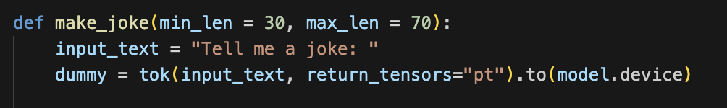
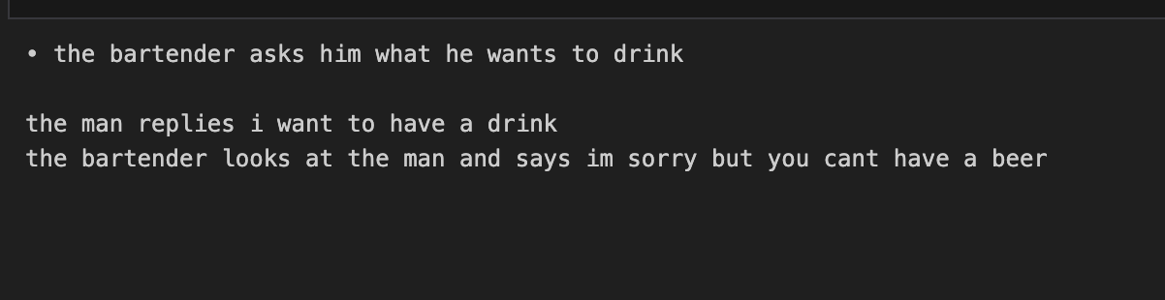
Results on BART
INPUT
GENERATED JOKE

Slide 15
GPT-2 for Joke Generation
used a pretrained GPT-2 language model for humor generation using HuggingFace TransFormers
a corpus of jokes is tokenized using a GPT-2 tokenizer with the EOS token as padding
the architecture is a unidirectional decoder-only transformer with causal self-attention
each joke is framed as a single language modeling task, where the model learns to predict the next token in the sequence
during training, we minimize the causal language modeling loss over full joke texts
at inference time, the model generates jokes autoregressively from an initial seed using greedy or sampling-based decoding strategies

Slide 16
GPT-2 Fine-Tuning with Humor Detection Feedback
fine-tuned a GPT-2 model using the HuggingFace Trainer API on a combined dataset of jokes from Jester, Reddit, and Stupidstuff, normalized and filtered using previously defined rating-based methods
only clean samples with a normalized rating above 0.5 are retained
prompts are masked during loss computation to direct learning toward punchlines
training is run for 3 epochs using mixed precision and saved for later use

Slide 17
Conclusions
for classification, BERT’s contextual embeddings clearly improve precision at the cost of reduced sensitivity in comparison with TF-IDF + Neural Network approach
the feedback-informed GPT-2 clearly produces the most engaging and varied jokes, demonstrating the value of using detection scores to filter and prioritize training examples
building on these results, future systems can combine TF–IDF’s broad recall with BERT’s precision in a cascade and leverage detection-guided feedback loops to refine generative models. Jointly optimizing both tasks promises more robust, contextually aware humor agents capable of both spotting and crafting jokes in real time

Slide 18
Limitations
Language and Cultural Scope:
training done exclusively on English-language jokes and news articles, limiting applicability to other languages and cultural humor traditions
Dataset Biases:
public joke corpora overrepresent short puns and one-liners; longer narrative or situational humor remains underexplored, and rating distributions reflect community preferences rather than objective funniness
Compute Requirements:
fine-tuning transformer models (BERT, GPT-2, BART) requires GPUs with substantial memory, which
may not be accessible for smaller research groups or real-time deployment
Evaluation Metrics:
our reliance on regression MSE and binary F1 overlooks subjective dimensions of humor (e.g. novelty, appropriateness), motivating the development of richer, human-centered evaluation frameworks

Slide 19
GitHub Repository Link:
Natural Language Processing Project GitHub Repository

